Slide 1
City of Brookhaven ALCOHOL PERMIT ANALYSIS
Major Brandon Gurley
July 25, 2017

Slide 2
Alcohol permit Analysis overview
The purpose of this analysis was to determine if a correlation existed between an increase in requested police presence and businesses with alcohol permits.
Analysis conducted to identify top ten businesses in the City of Brookhaven with alcohol permits based on highest frequency of:
Calls for Service (CFS)
Disorderly Person, Noise Complaint, Person Drunk, Discharging Firearms, Accident, Information for Officer
Incidents Reported
Aggravated Assault, Robbery, Entering Auto, MVT, Possession of Controlled Substance
Timeframe for analysis: January 1, 2016 – May 15, 2017
73 businesses identified as having active alcohol permits
Top 10 locations were identified based on highest amount of requested police presence and analysis was conducted to determine timeframe for majority of incidents and calls for service for each location

Slide 3
Top TEN identified businesses with alcohol permits
Business | Business Street Address | Calls For Service | Incidents
RUSH LOUNGE | 2715 BUFORD HWY | 204 | 77
MEDUSA | 3375 BUFORD HWY, SUITE 1170 (Northeast Plaza) | 195 | 75
MPR, INC | 3375 BUFORD HWY. SUITE 1130 (Northeast Plaza) | 195 | 75
REMIX LOUNGE | 3375 BUFORD HWY STE. 1050 (Northeast Plaza) | 195 | 75
SUNRISE BISTRO | 3375 BUFORD HWY STE 1170 (Northeast Plaza) | 195 | 75
PEGASUS | 3375 BUFORD HWY, SUITE 1050 (Northeast Plaza) | 195 | 75
PINK PONY | 1837 CORPORATE BLVD | 116 | 49
XS LOUNGE | 3337 BUFORD HWY | 113 | 33
CONFETI'S | 3045 BUFORD HWY | 106 | 27
JOSEPHINE'S LOUNGE | 3277 BUFORD HWY | 62 | 30

Slide 4
BUSINESSES WITH ALCOHOL PERMITS timeframe for REPORTED incidents
There were 291 reported incidents between 01/01/2016 and 05/15/2017 at the top ten businesses
69% of those incidents occurred between 12AM and 6AM
69%
3%
11%
17%

Slide 5
BUSINESSES WITH ALCOHOL PERMITS 12AM – 6AM hour breakdown
12AM - 6AM represented 69% of all reported incidents
In a 24 hour period, 22% of incidents occurred between 3AM – 4AM
22%
17%
13%
11%
5%

Slide 6
BUSINESSES WITH ALCOHOL PERMITS timeframe for calls for service
Of the 795 calls for service received at the top ten alcohol serving businesses, 479 occurred between 12AM and 6AM, representing 60% of the total calls for service
60%
19%
10%
11%

Slide 7
BUSINESSES WITH ALCOHOL PERMITS 12AM – 6AM hour breakdown
12AM - 6AM represented 60% of all calls for service
In a 24 hour period, 22% of calls occurred between 3AM - 4AM
22%
15%
10%
8%
4%

Slide 8
City of Brookhaven Dui incidents
Between 01/01/2016 and 05/15/2017, there were 236 DUI incident reports within the City of Brookhaven
65% of the total DUI incidents occurred between 12AM and 6AM
65%
7%
4%
24%

Slide 9
Dui incident BREAKDOWN - 12AM – 6AM
20% of all DUI incidents occurred between 3AM - 4AM
20%
11%
12%
10%
9%
3%

Slide 10
Dui Offenders’ residential addresses
Of the DUI incidents between 3AM and 4AM, 72% of the offenders lived outside the City of Brookhaven

Slide 11
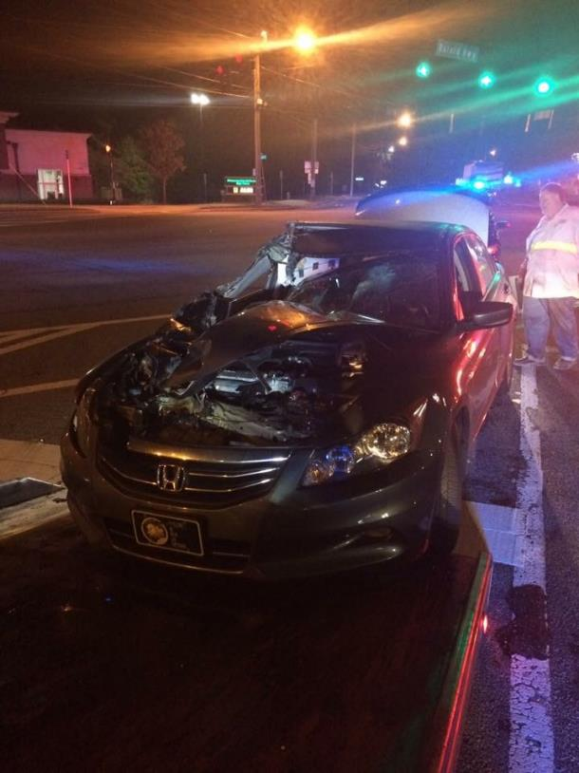
Dui crash – November 6, 2016 at 3:45AM
Motor vehicle crash at Buford Hwy and Clairmont Road that occurred at 3:45AM
Driver of vehicle was determined to be under the influence of alcohol and was subsequently arrested
Offender arrested for DUI stated he was coming from XS Lounge (3337 Buford Hwy)
Offender had a home address in Smyrna, GA

Slide 12
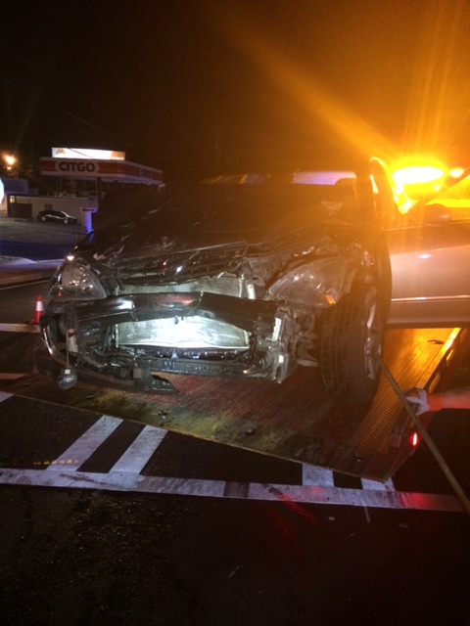
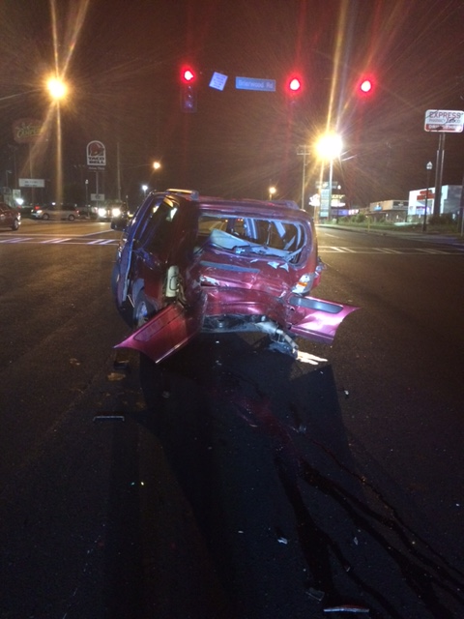
Dui crash – May 30, 2015 at 5:00AM
Motor vehicle crash at Buford Hwy and Briarwood Road that occurred at 5:00AM
Driver of vehicle fled the scene but was later apprehended and determined to be under the influence of alcohol
Offender was arrested for DUI and Hit and Run
Offender advised he had been to Confeti’s 3045 Buford Hwy
Offender had a home address in Marietta, GA

Slide 13
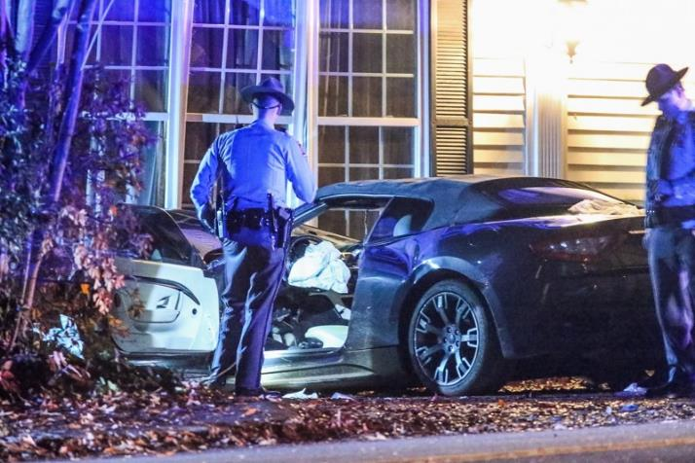
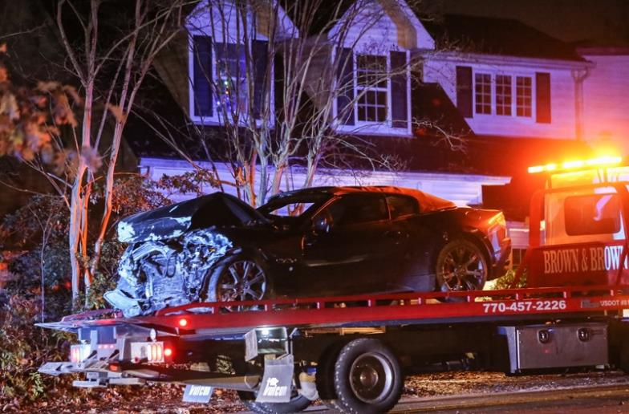
Dui crash – December 7, 2016 at 2:39am
Vehicle crash involving a Maserati sports car that had driven into the front of the house on North Druid Hills Road following a chase with GSP
The driver of the vehicle died as a result of the crash
It was determined that the driver was under the influence of alcohol
Driver had a home address in Duluth

Slide 14
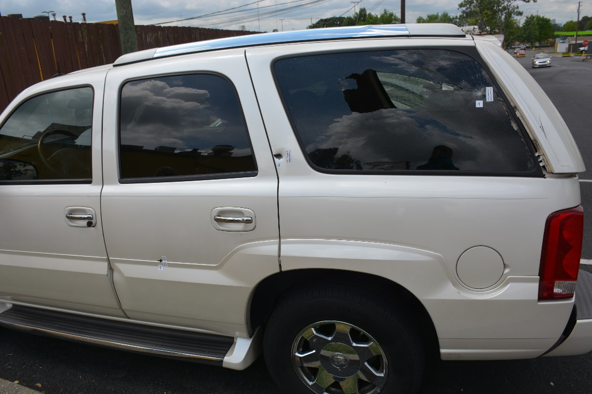
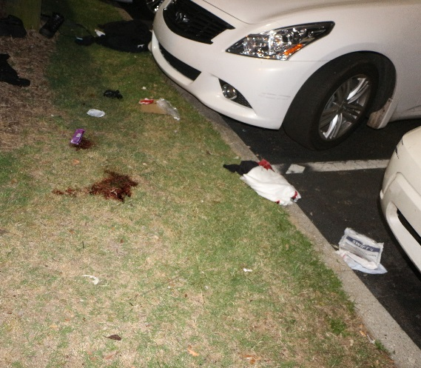
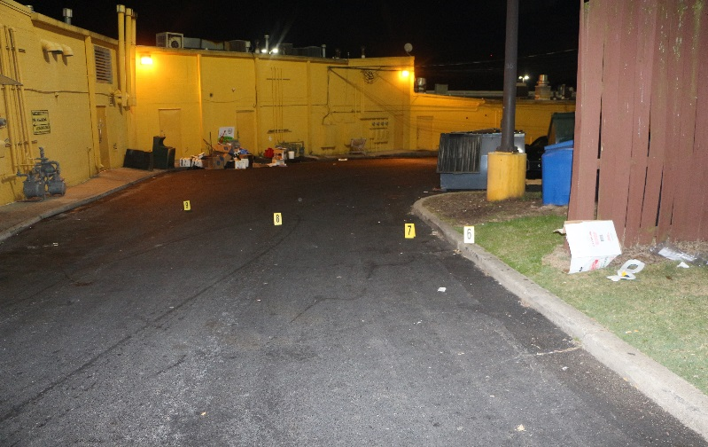
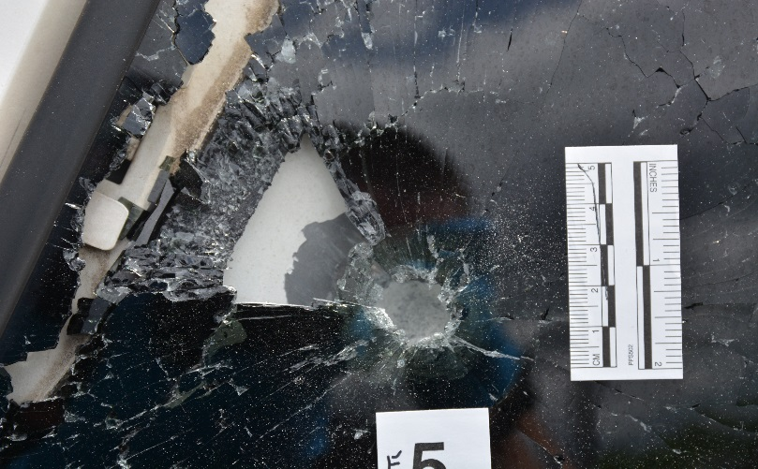
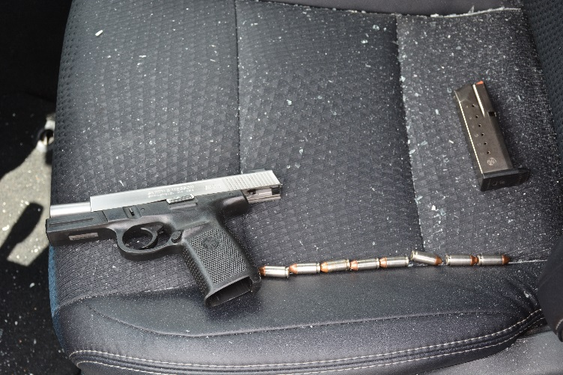
Aggravated Assault at Medusa
Aggravated assault that occurred at Medusa (3375 Buford Hwy) on 5/13/2017 at 3AM
Altercation led to more than 30 shots being fired
Occurred in the parking lot between multiple patrons of the club
Three individuals injured as a result of the shooting; one of which was shot in the head
Several vehicles in the parking lot were struck by gunfire

Slide 15
Aggravated Assault at rush lounge
Conflict started inside of club, but physical altercation took place in the parking lot of Rush Lounge between the victim and two suspects
Stabbing took place as the club was closing on 7/6/16 at 3:15 AM
One suspect began cutting the victim in the head and hand
Victim was transported to hospital due to injuries
Victim was stabbed in the parking lot at Rush Lounge and then drove to the car wash across the street where police responded
Incident would have been attributed to Rush Lounge but did not count towards statistics due to report being taken at alternate location
Two suspects involved in the stabbing were arrested and charged with Aggravated Assault

Slide 16
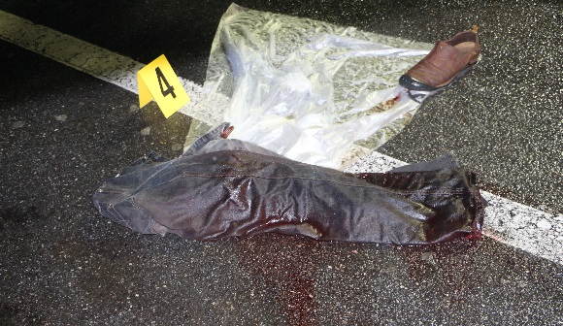
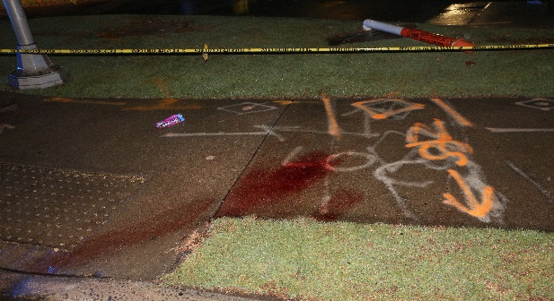
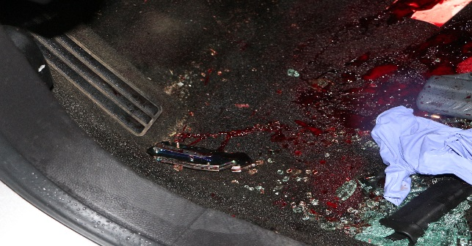
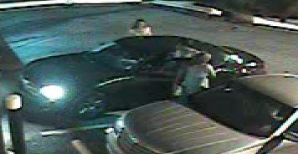
Aggravated assaults after leaving clubs
stabbing at McDonald's
shooting AT WAFFLE HOUSE
Aggravated assault that occurred at McDonald’s (2210 N Druid Hills Rd) on 5/21/2017 at 2:30 AM
Altercation ensued between two individuals which resulted in one of the individuals stabbing the victim multiple times in the McDonald’s parking lot after leaving a club
Suspect was arrested for aggravated assault
Altercation took place at Waffle House on Buford Hwy on 2/27/2017 at 4:20 AM
Victim had a verbal argument with a group of individuals and the suspect fired one round from a handgun, striking the victim’s vehicle
All parties involved had just left Rush Lounge

Slide 17
CONCLUSIONS
69% of all incidents reported at establishments serving alcohol occurred between 12AM – 6AM
60% of all calls for service at establishments serving alcohol occurred between 12AM – 6AM
65% of all DUIs for the City of Brookhaven occurred between 12AM – 6AM
In a 24 hour day, the following statistics can be attributed to a single hour (3AM – 4AM)
At locations with alcohol permits, 22% of all calls for service
At locations with alcohol permits, 22% of all incidents
20% of all DUI arrests occur
72% of these offenders lived outside the City of Brookhaven
This analysis demonstrates that requested police presence increases dramatically the longer each alcohol serving establishment remains open and spikes between 2AM and 4AM.

Slide 18
Alcohol permit ANALYSIS - update
As a follow-up to the initial analysis, updated calls for service and reported incidents were pulled to include 2017 YTD.
Top 10 locations previously identified were pulled a secondary time to determine timeframe for majority of incidents and calls for service for each respective location
Calls for Service (CFS)
Disorderly Person, Noise Complaint, Person Drunk, Discharging Firearms, Accident, Information for Officer
Incidents Reported
Aggravated Assault, Robbery, Entering Auto, MVT, Possession of Controlled Substance
Timeframe for secondary analysis: May 16, 2017 to July 23, 2017

Slide 19
BUSINESSES WITH ALCOHOL PERMITS timeframe for REPORTED incidents - update
There were 46 reported incidents between 05/16/2017 and 07/23/2017 at the top ten businesses
61% of those incidents occurred between 12AM and 6AM
61%
17%
17%
4%

Slide 20
BUSINESSES WITH ALCOHOL PERMITS - update 12AM – 6AM hour breakdown
12AM - 6AM represented 61% of all reported incidents
In a 24 hour period, 34% of the incidents occurred between 2AM – 4AM
17%
17%
17%
7%

Slide 21
BUSINESSES WITH ALCOHOL PERMITS - update timeframe for calls for service
Of the 89 calls for service received at the top ten alcohol serving businesses, 55 occurred between 12AM and 6AM, representing 62% of the total calls for service
62%
20%
8%
10%

Slide 22
BUSINESSES WITH ALCOHOL PERMITS - update 12AM – 6AM hour breakdown
12AM - 6AM represented 62% of all calls for service
In a 24 hour period, 36% of calls within this timeframe occurred between 2AM - 4AM
19%
17%
13%
9%
3%

Slide 23
City of Brookhaven Dui incidents - update
Between 05/16/2017 and 07/23/2017, there were 15 DUI incident reports within the City of Brookhaven
60% of the total DUI incidents occurred between 12AM and 6AM
60%
20%

Slide 24
Dui incident BREAKDOWN - 12AM – 6AM - update
12AM - 6AM represented 60% of all DUI incidents
In a 24 hour period, 33% of DUI incidents occurred between 2AM - 4AM
20%
13%
13%
13%

Slide 25
Dui Offenders’ residential addresses - update
Of the DUI incidents between 2AM and 4AM, 100% of the offenders lived outside the City of Brookhaven

Slide 26
17-004383: Theft by receiving stolen vehicle, Marijuana (With Intent), Weapons Violation
On 7/11/2017, BPD officer initiated a traffic stop on a white Mercedes
After speaking with the driver, a probable cause search of the vehicle was conducted and the following items were located:
“Gummy Legos” that tested positive for THC
A .40 Cal handgun and .300 blackout rifle
Stack of cash in the center console
Vehicle was determined to be stolen
Individual arrested identified himself as an associate of Medusa

Slide 27
17-004514: Possession of a firearm by a felon, possession of controlled substance
On 7/15/17, BPD officer initiated a traffic stop on a Chevrolet Tahoe
Search of the vehicle revealed drugs, over $1000 in cash, and a firearm
Subject was on probation for trafficking narcotics
Offender identified himself as head of security for Medusa and stated he was on his way to Medusa at the time of the stop

Slide 28
BUSINESSES WITH ALCOHOL PERMITS timeframe for REPORTED incidents - combined
There were 337 reported incidents between 01/16/2016 and 07/23/2017 at the top ten businesses
68% of those incidents occurred between 12AM and 6AM
68%
12%
17%
3%

Slide 29
BUSINESSES WITH ALCOHOL PERMITS – combined 12AM – 6AM hour breakdown
12AM - 6AM represented 68% of all reported incidents
38% of ALL incidents occurred between 2AM – 4AM (24 hour timeframe)
21%
17%
12%
12%

Slide 30
BUSINESSES WITH ALCOHOL PERMITS - combined timeframe for calls for service
Of the 884 calls for service received at the top ten alcohol serving businesses, 534 occurred between 12AM and 6AM, representing 60% of the total calls for service
60%
19%
10%
11%

Slide 31
BUSINESSES WITH ALCOHOL PERMITS – combined 12AM – 6AM hour breakdown
12AM - 6AM represented 60% of all calls for service
37% of ALL CFS occurred between 2AM – 4AM (24 hour timeframe)
22%
15%
9%
10%
1%
4%

Slide 32
CONCLUSIONS - update
Between 05/16/2017 and 07/23/2017:
61% of all incidents reported at establishments serving alcohol occurred between 12AM – 6AM
62% of all calls for service at establishments serving alcohol occurred between 12AM – 6AM
60% of all DUIs for the City of Brookhaven occurred between 12AM – 6AM
In a 24 hour day, the following statistics can be attributed to two hours (2AM – 4AM)
At locations with alcohol permits, 34% of calls for service
At locations with alcohol permits, 36% of incidents reported
33% of all DUI arrests occur
100% of these offenders lived outside the City of Brookhaven
This secondary analysis continues to demonstrate that requested police presence increases dramatically the longer each alcohol serving establishment remains open and spikes between 2AM and 4AM.

