Slide 1
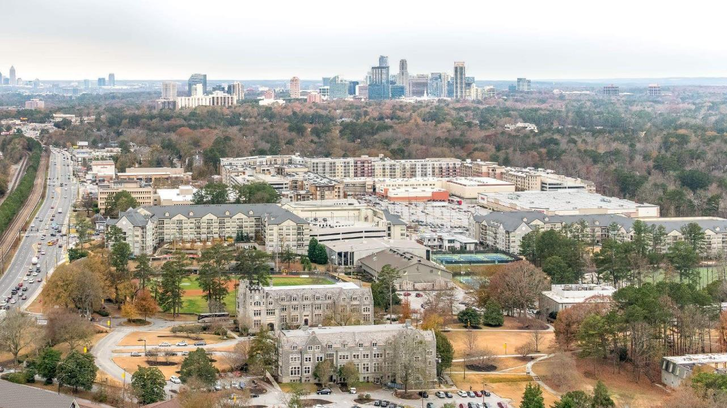

BROOKHAVEN DEMOGRAPHICS
2019

Slide 2
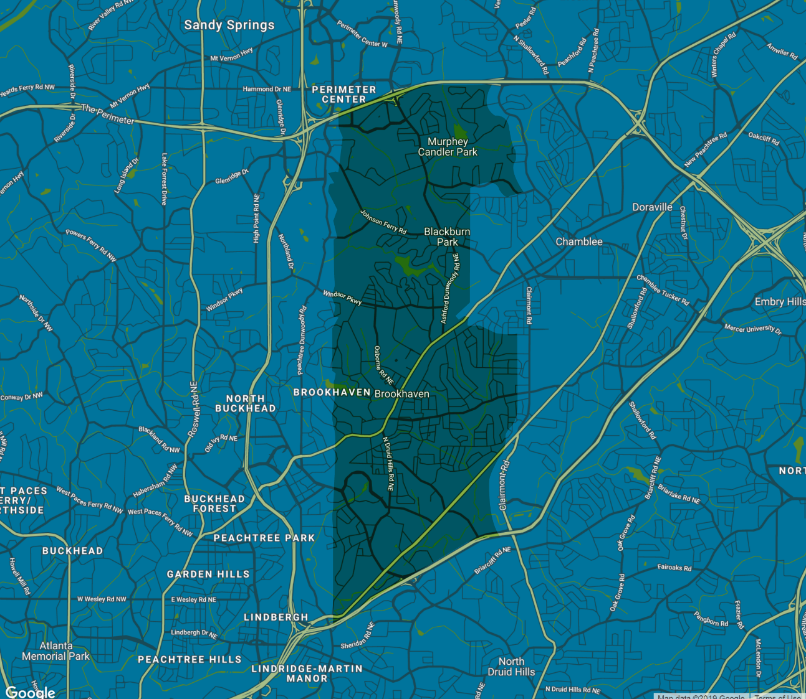
2014 Population vs.
2019 Population:
43,344
2014 Brookhaven only
53,518
2019 Brookhaven only

Slide 3
Population by Race

Slide 4

Population by Race

Slide 5




Population by Age in 2014
Brookhaven
9.1%
20%
26.1%
11.8%
UNDER 5 YEARS
UNDER 18 YEARS
21 – 34 YEARS
PERSONS 65+
49.7%
50.2%
Female
Male

Slide 6




Population by Age in 2019
Brookhaven only
9.6%
22.7%
21.7%
9.3%
UNDER 5 YEARS
UNDER 18 YEARS
21 – 34 YEARS
PERSONS 65+
49.4%
50.5%
Female
Male

Slide 7

Population by Age in 2019
20-mile radius/Metro Atlanta
6.5%
23.7%
19.9%
11.9%
UNDER 5 YEARS
UNDER 18 YEARS
21 – 34 YEARS
PERSONS 65+
51.63%
48.3%
Female
Male

Slide 8
60,891
2024 Projected Population

Slide 9

Live, work, and/or
play community?
Daytime population of Brookhaven
20,127
Workers
22,676
Residents

Slide 10

Labor Force
Civilian labor force (Age 16+)
79.9%
76.9%

Slide 11

Labor Force
Travel time to work in minutes
2014
2019
24.3
26.1
Minutes
Minutes

Slide 12

Education
87.4%
87.4%

Slide 13

Education
57.7%
63.2%

Slide 14
Housing
TOTAL HOUSEHOLD UNITS
PERSONS PER HOUSEHOLD
FAMILY HOUSEHOLDS
23,239
2.3
49.1%
2014
2014
2014
21,780
2.29
47.3%
2019
2019
2019

Slide 15
Housing
OWNER OCCUPIED
MEDIAN GROSS RENT
MEDIAN HOME VALUE
49.1%
$1,076
$365,000
2014
2014
2014
48.4%
$1,255
$419,800
2019
2019
2019

Slide 16
Income
PERSONS IN POVERTY
10.2%
2014
14.1%
2019

Slide 17
Median Household Income

Slide 18
Educational Attainment
Bachelor’s degree or higher
2019
2019
2019
2019
87.4%
87.4%
63.2%
61.1%
66.3%
38.2%
Sandy Springs
Dunwoody
Chamblee
Brookhaven

Slide 19
Median Home Values
2018
2018
2018
2018
$495,500
$455,500
$253,822
$419,800
Sandy Springs
Dunwoody
Chamblee
Brookhaven

Slide 20
Tax Digest: Citywide
Ranking | Value
2014 | 979,656,758
2015 | 1,121,043,473
2016 | 1,265,953,951
2017 | 1,419,025,031
2018 | 1,610,457,965
64.3% increase in commercial property value city-wide from 2014 to 2018

Slide 21
Tax Digest: Buford Highway
54.58%
Property value increase in
strategic parcels along
Buford Highway corridor
from 2014-2018

Slide 22
Buford Highway Strategic Parcels

Slide 23
Census Timeline
Jan. 2018-Sept. 2019
Apr. 2019-Jan. 2020
Mar. 2020-June 2020
Engage and Educate leaders, partners, and communities
Promote participation in the census locally
Call to action for residents to respond

Slide 24
Census Timeline
April 1, 2020
Aug. 2020-Sept. 2020
Dec. 31, 2020
Census day
Area census offices close
Deliver counts to the President

Slide 25
KEEP IN TOUCH
Shirlynn.brownell@brookhavenga.gov
Brookhavenga.gov

Slide 26
THANK YOU

